Slide 1

NASA SPACEAPPS HACKATHON
Spatial Mapping of Life Expectancy: The Impact of Healthcare, Income, and Literacy
BY TEAM ASTROFREAKS

Slide 2


Project overview
Exploring the Determinants of Life Expectancy: The project investigates how life expectancy varies across different regions based on three critical factors:
Healthcare Accessibility: Proximity to hospitals, clinics, and other healthcare facilities.
Income Levels: Economic status, which influences access to nutrition, healthcare, and living conditions.
Literacy Rates: Educational attainment, which plays a role in health awareness and the ability to access medical services.
Spatial Representation and Mapping: By using open-source geographic data, the project spatially visualizes these factors on a map, helping to pinpoint geographic disparities. The map allows for a deeper understanding of how physical proximity influences life expectancy in different areas of the community. The project sheds light on the importance of spatial and socio-economic factors in determining life expectancy and can serve as a tool to advocate for equitable healthcare, education, and economic support in underserved areas.
OBJECTIVES
Identify Vulnerable Areas: Highlight areas with poor healthcare access, low income, and low literacy, which are likely to have lower life expectancy and map them creating a visual representation.
Analyze Geographic Disparities: Demonstrate how these socioeconomic factors interact spatially to affect health outcomes and analyze them to determine possible factors affecting the given region.
Provide Insight for Policy and Intervention: Provide policymakers and community leaders with critical insights into regions that require targeted interventions in health, education, or economic development. Additionally, offer the general public access to accurate, data-driven information, empowering them to better understand and assess their local conditions. This data can be instrumental in shaping informed decisions and fostering community-wide engagement to address disparities and improve overall well-being.
Support policymakers in addressing health inequities and enhancing the overall quality of life for India's most vulnerable populations.

Slide 3
implementation
1. Data Collection:
Sources: We gathered open-source data from government websites and platforms like Kaggle, focusing on datasets related to healthcare facilities, income levels, literacy rates, and life expectancy.
Format: The data was either extracted in the form of CSV files or was converted in the CSV format as it assisted us in smooth layering of data onto the map.
2. Data Processing and Analysis:
Python Libraries: We used Python along with libraries like Pandas for data cleaning, filtering, and manipulation, and NumPy for numerical computations.
Data Cleaning: The datasets were cleaned to remove inconsistencies, missing values, and duplicates. The data was then organized into categories based on proximity to healthcare, income brackets, and literacy levels.
Analysis: Key insights were drawn by analyzing the relationship between life expectancy and the three factors (healthcare, income, literacy) using correlation analysis.

Slide 4
3. Spatial Mapping with QGIS:
Mapping Software: We used QGIS, an open-source geographic information system (GIS), to map the data spatially.
Layering: The cleaned data was layered to visualize life expectancy across regions and its correlation with healthcare access, income, and literacy rates.
Color-Coded Maps: We created color-coded maps to highlight areas of high and low life expectancy, along with variations in other factors.
4. Visualization and Graphing:
Matplotlib: We employed Matplotlib, a Python plotting library, to visualize the data with graphs that compare life expectancy against healthcare access, income levels, and literacy.
Correlation Matrix: A correlation matrix was generated to illustrate the interdependencies between the different factors and life expectancy.
Interactive Elements: The visualizations were made interactive, allowing users to select specific graphs and see corresponding maps for deeper insights.

Slide 5
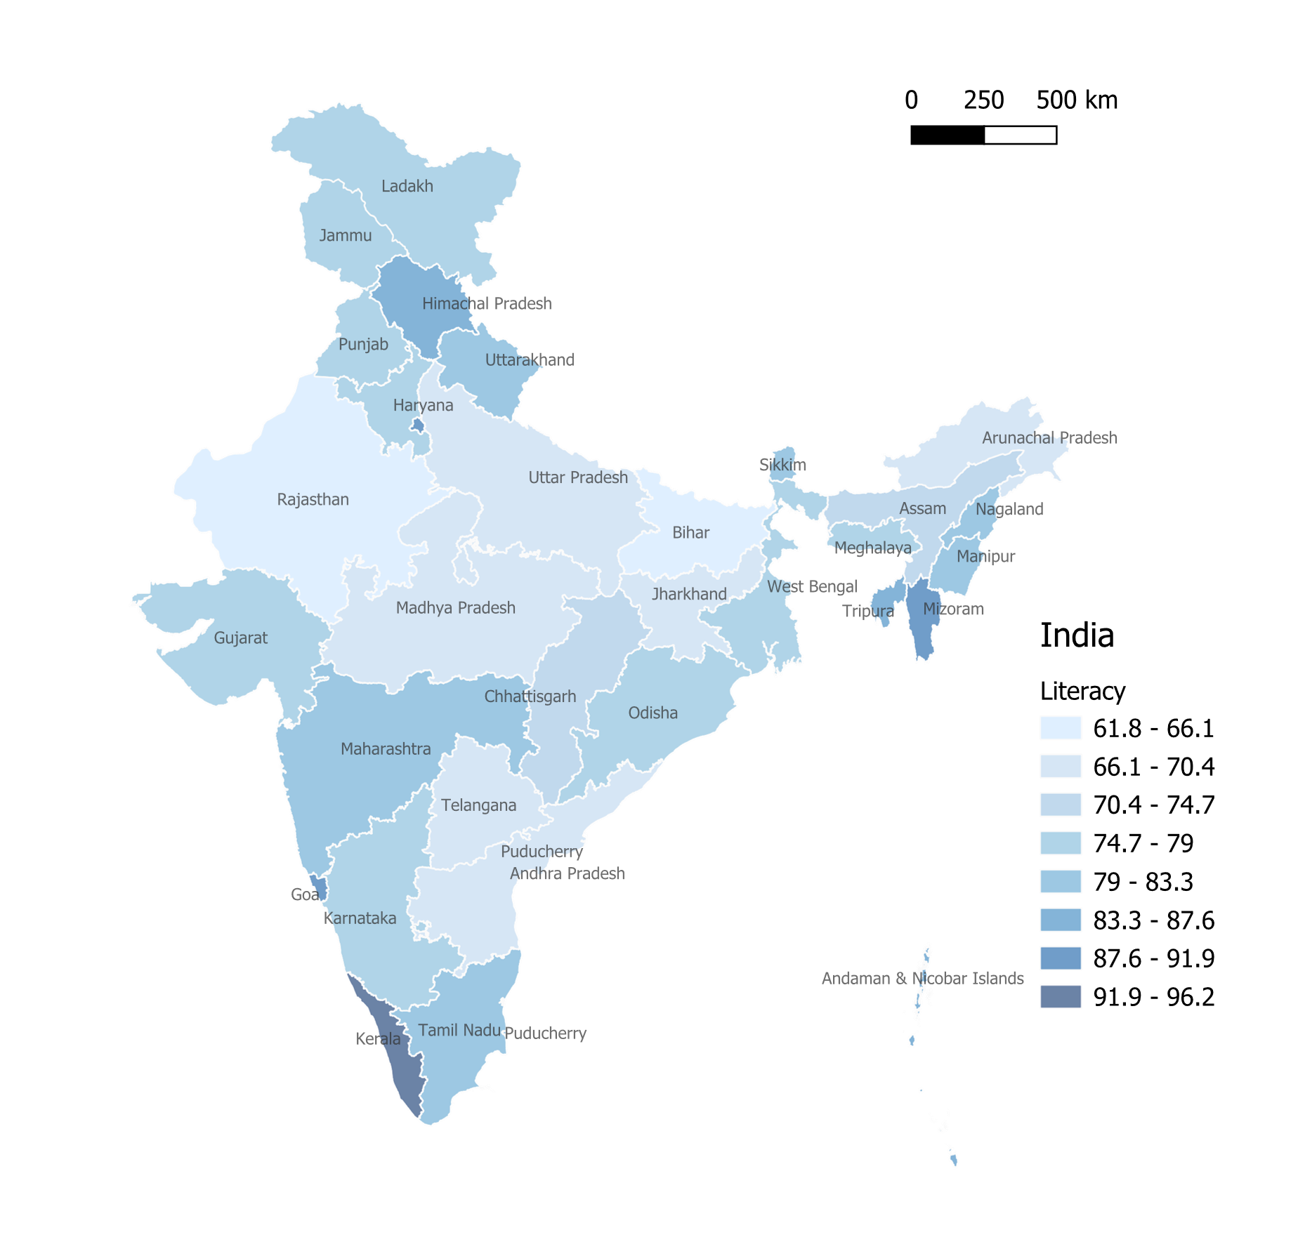
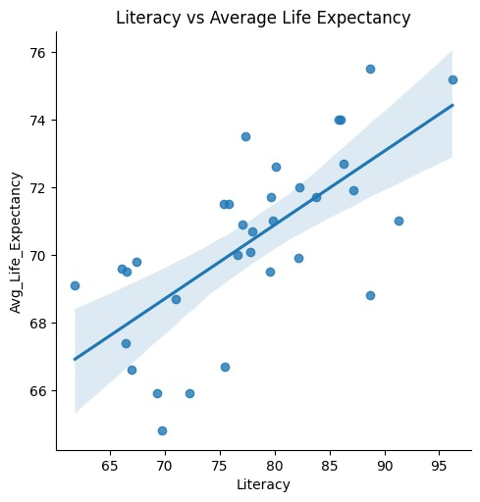
Literacy v/s life expectancy
General trend is that literacy rates and life expectancy have a correlation. States with lower literacy levels generally tend to have lower life expectancy for example KERALA, it has a literacy rate of 96% and has a significantly higher life expectancy than BIHAR whose rate drastically drops down to however other quality of life factors also play a significant role.

Slide 6
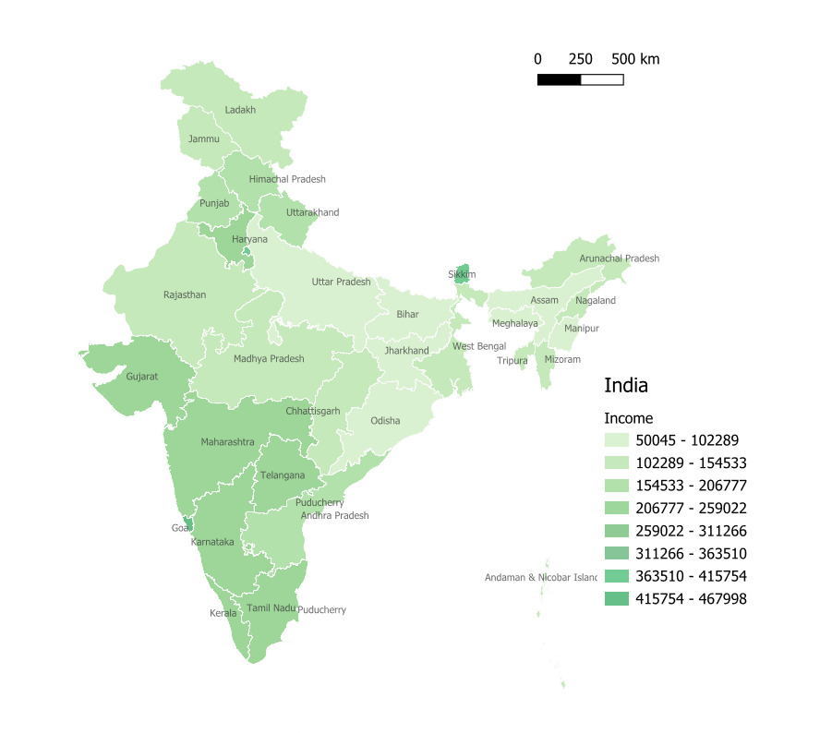
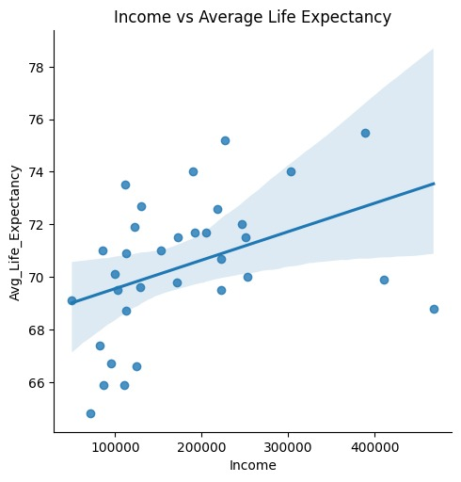
Avg Anuual Income with Avg. Life Expectancy
Here we can observe a general correlation between annual income and life expectancy.
But there are multiple discrepancies , where icome doesn’t translate to better health outcomes.

Slide 7
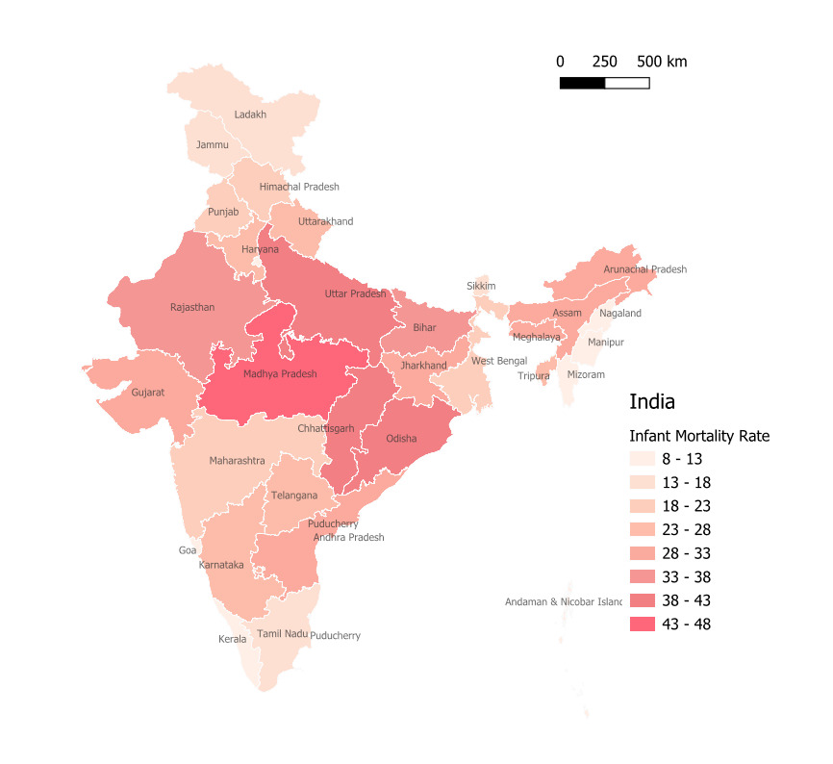
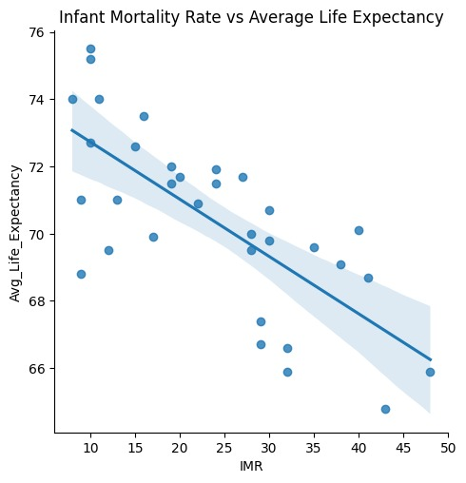
Infant Mortality Rate with Avg. Life Expectancy
The graph and state-wise map reveal that regions with high infant mortality rates tend to have lower life expectancy, indicating poor healthcare quality. Areas with better healthcare facilities show lower IMR and higher life expectancy, highlighting the critical role healthcare access plays in improving survival rates and overall lifespan.

Slide 8
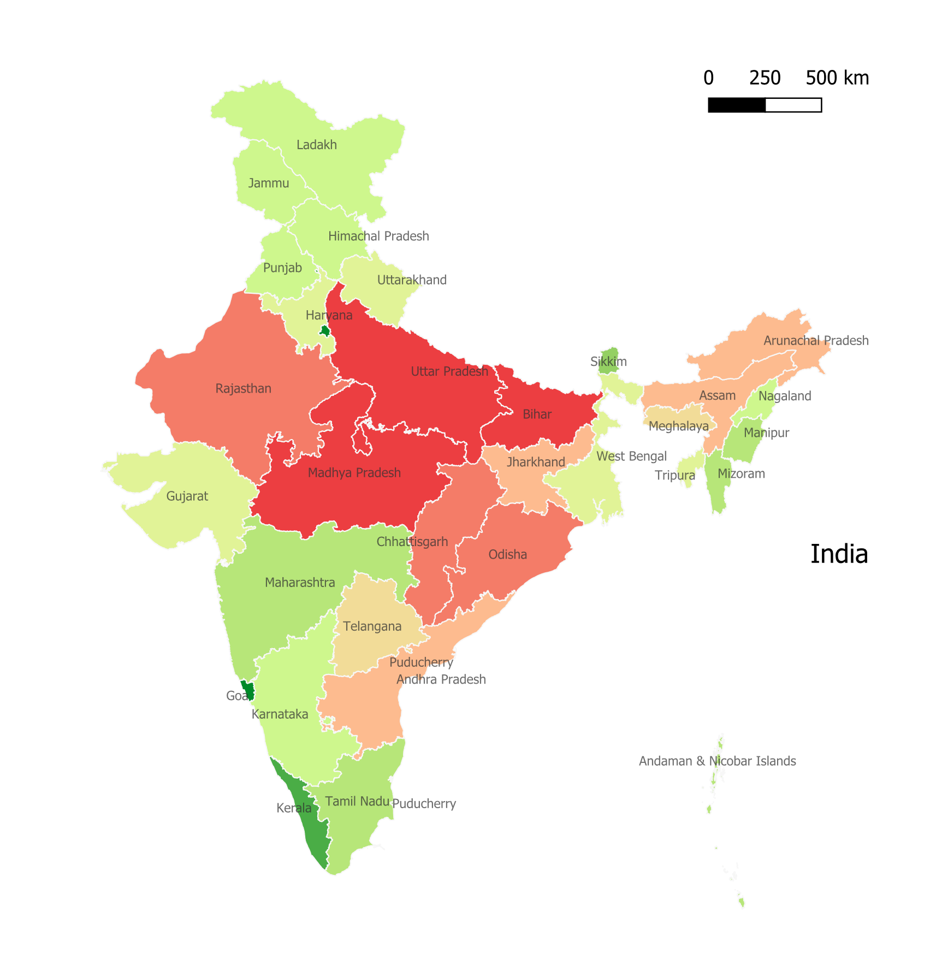
FINAL interpretation
Since quality life factors and socio-economic situations are often complex, we tried to map Life Expectancy of different states while trying to co-relate with other aspects using AI.
This gives a more accurate representation, and helps us identify and help vulnerable regions better.
This also helps us significantly reduce the earlier discrepancies, and get a better outlook .

Slide 9
THANK you

